Slide 1
C# .NET

Slide 2
C# Introduction
It Was developed by the Microsoft Corporation.
It is high level programming language.
It is an object oriented programming language.
It is case sensitive programming language.
It extension .cs.
It is a very easy programming language.
It belongs to C family.
It is used to develop various types applications.
Console,Windows,Web and Mobile applications.

Slide 3
C# Program Structure
Predefined Namespaces
User defined Namespace
Class Declaration
Data types
Methods.

Slide 4
Structure Definitions
Namespace
It is set of classes,interfaces,enumerations,deligates etc….
Class
It is the collection of datatypes and methods.

Slide 5
C# Program Structure
using System;
using System.Collections.Generic;
using System.Linq;
using System.Text;
namespace Test {
class Program
{
static void Main(string[] args)
{
}
}
}
Predefined Namespaces
User defined Namespace
Class Declaration
Method
Document Area

Slide 6
How to develop a program in C#?
Open the project
Code the program using C#.
Execute using Ctrl+F5.
These Steps will be repeated for all the programs.

Slide 7
Visual Studio Introduction
It is an IDE(Integrated Development Environment).
It is used develop software , web and Mobile applications.
It is Introduced by Microsoft.
In order to work with any project in Visual Studio tool we need know about Solution Explorer and Server Explorer .
Solution Explorer in which project and its respect files can be added.
Sever Explorer in which Databases can deal the with the DataBases.

Slide 8
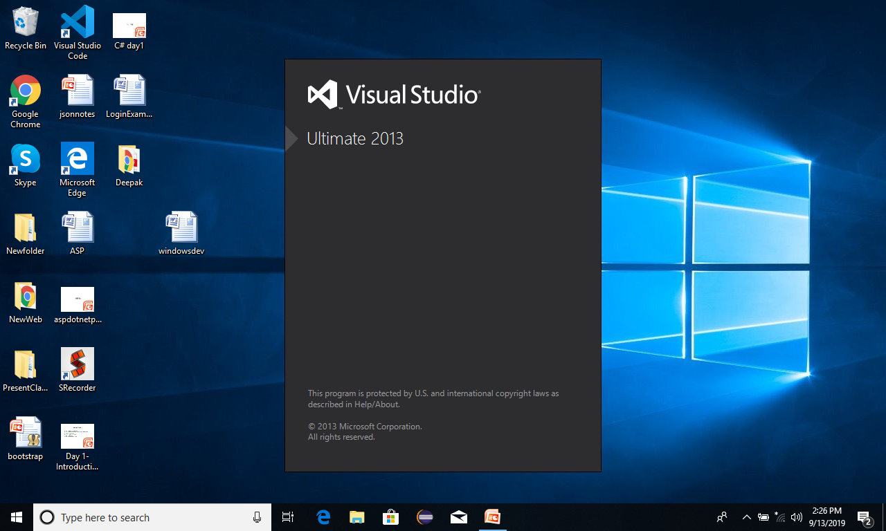
Creating new project in VS

Slide 9
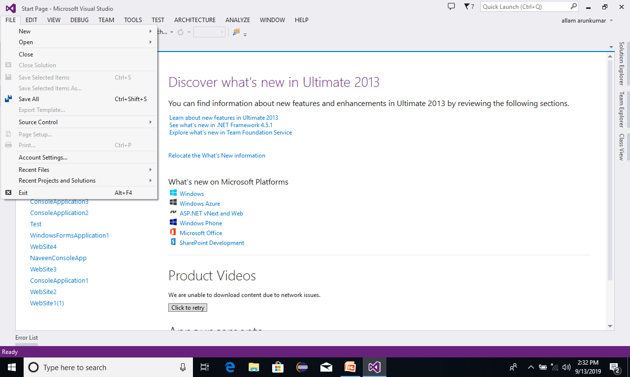
Creating new project in VS

Slide 10

Creating new project in VS

Slide 11
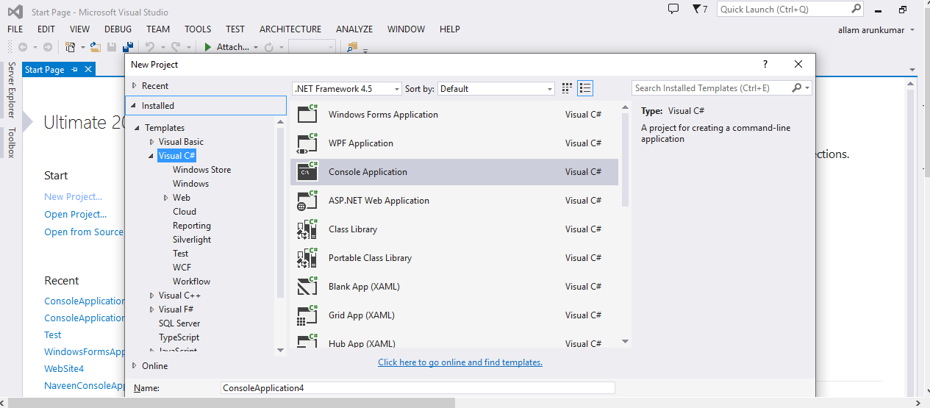
Creating new project in VS
Programming language
Application Type
Application Name

Slide 12
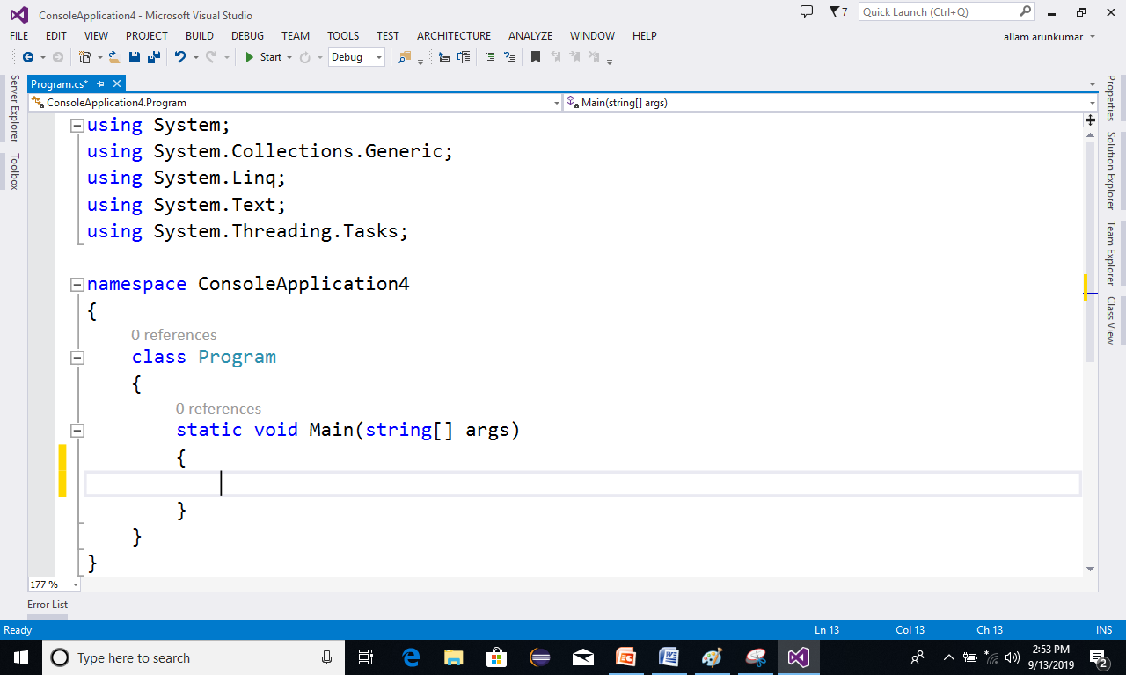
Coding new program in VS

Slide 13
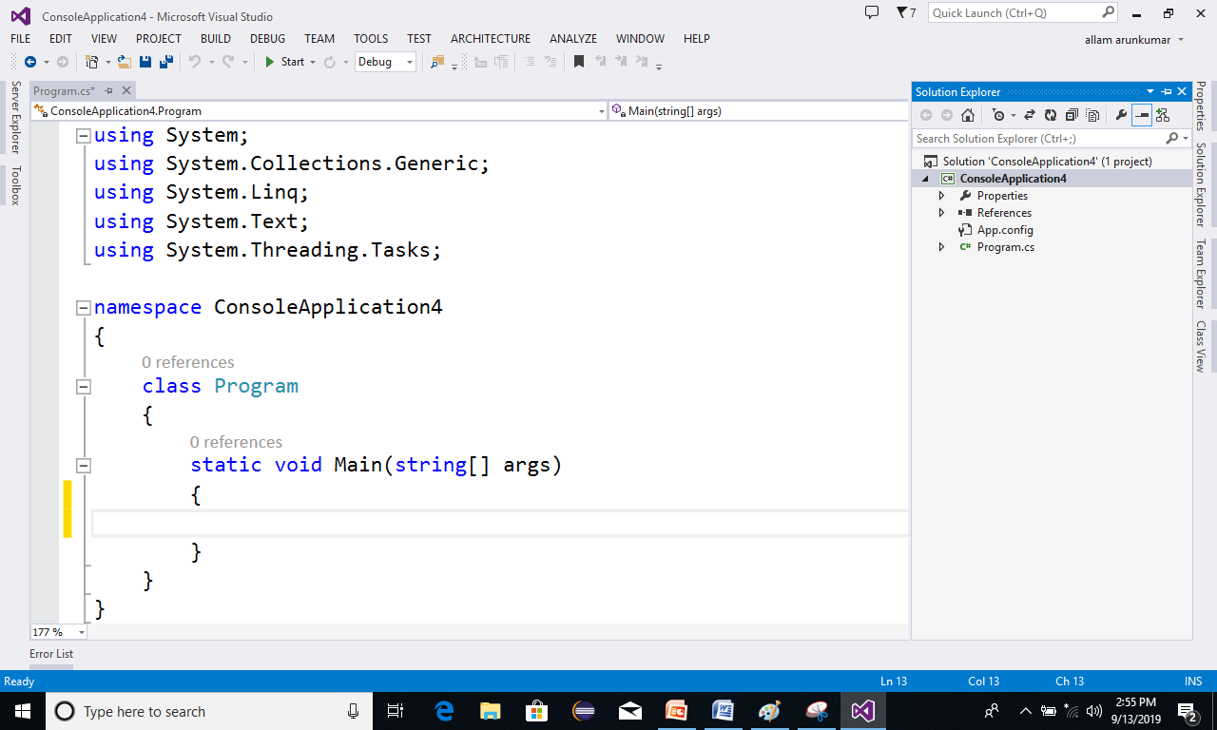
Coding new program in VS
Solution Explorer in which,
we Add Files to the project,
all the files which are present project will be seen here
Document Area where work here

Slide 14
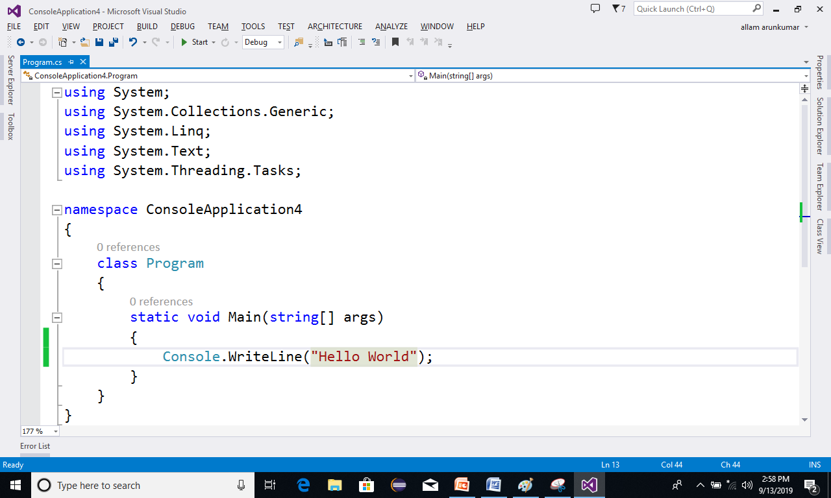
Coding new program in VS
After writing the code
press CTRL + F5
To
Execute the Program

Slide 15
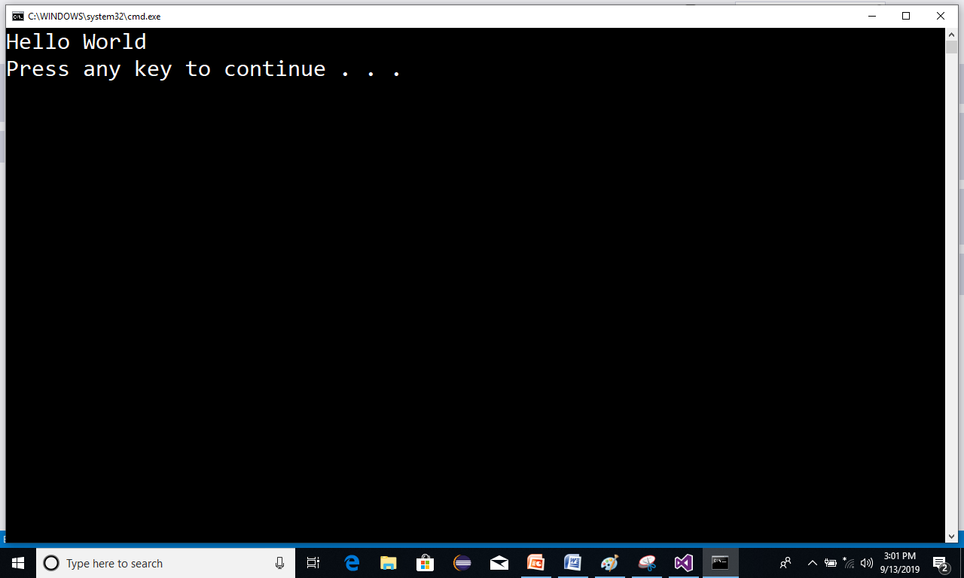
Coding new program in VS
After Executing the project We get
out put.

Slide 16
Data Types in C#
char 1 byte
int 4 byte
float 4 byte
double 8 byte
decimal 16 byte
String
Class
Bool - 1byte
Byte - 1byte
Sbyte - 1byte
Short - 2bytes
Ushort – 2bytes
Long - 8 bytes
Ulong- 8 bytes

Slide 17
Input and Out Put Methods
Out put Methods
These methods can be used to display the statements and values inside the console App.
They are
Console.WriteLine()
Console.Write()

Slide 18
Input and Out Put Methods
Input Methods
These are used to read values from the console.
Tyey are
Console.ReadLine()
Console.Read()
Console.ReadKey()

Slide 19
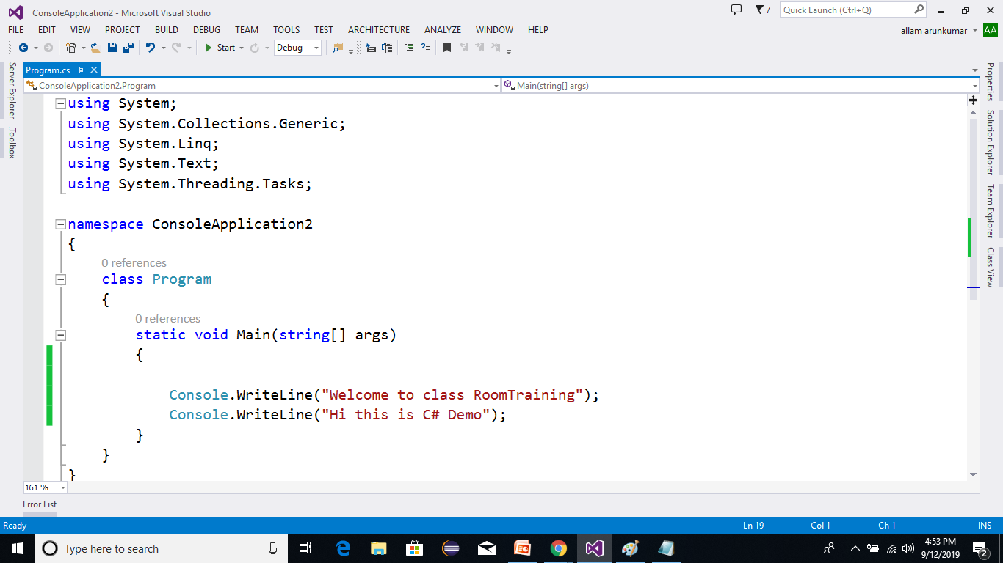
Example on out put methods

Slide 20
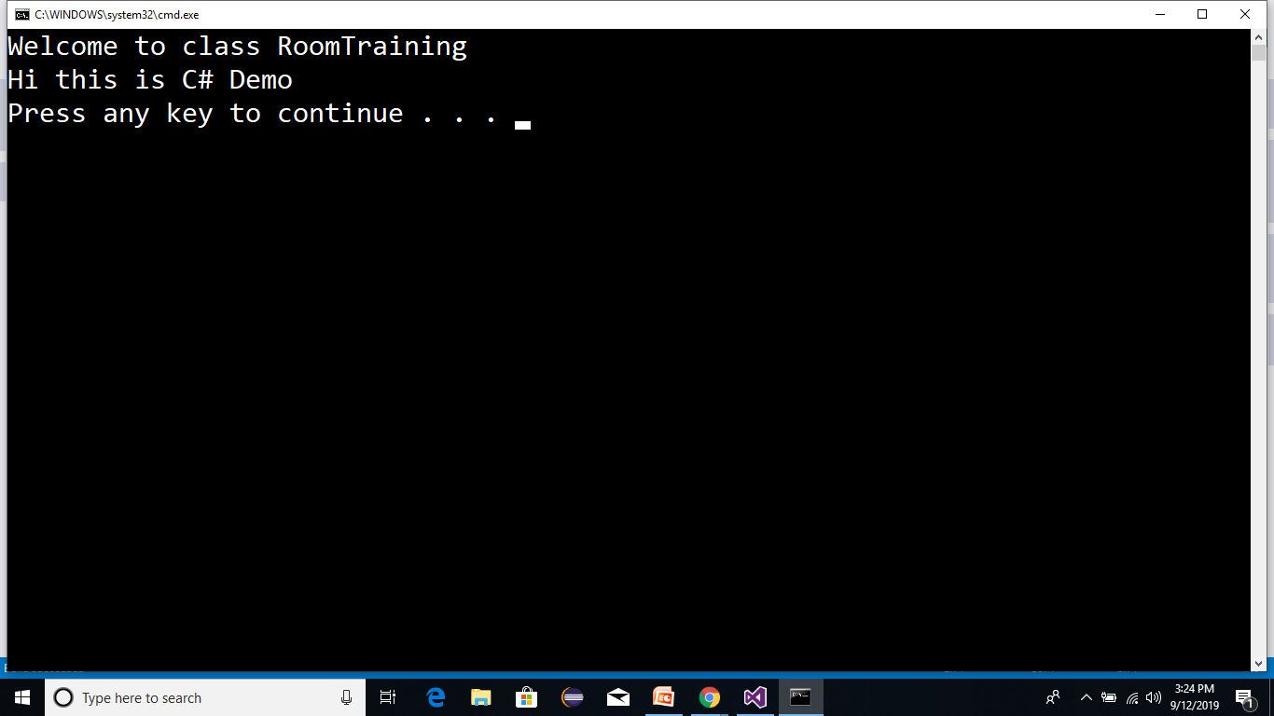
Coding new program in VS
After Executing the project We get
out put.

Slide 21
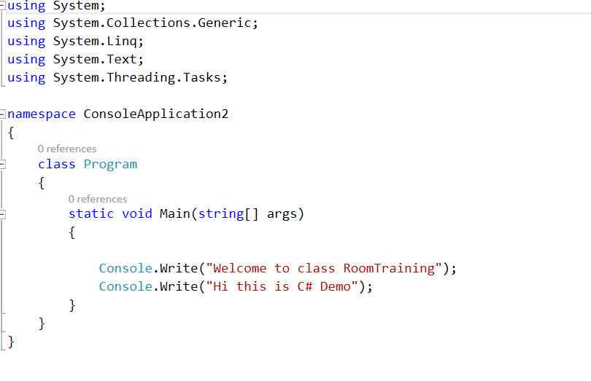
Example on out put methods

Slide 22
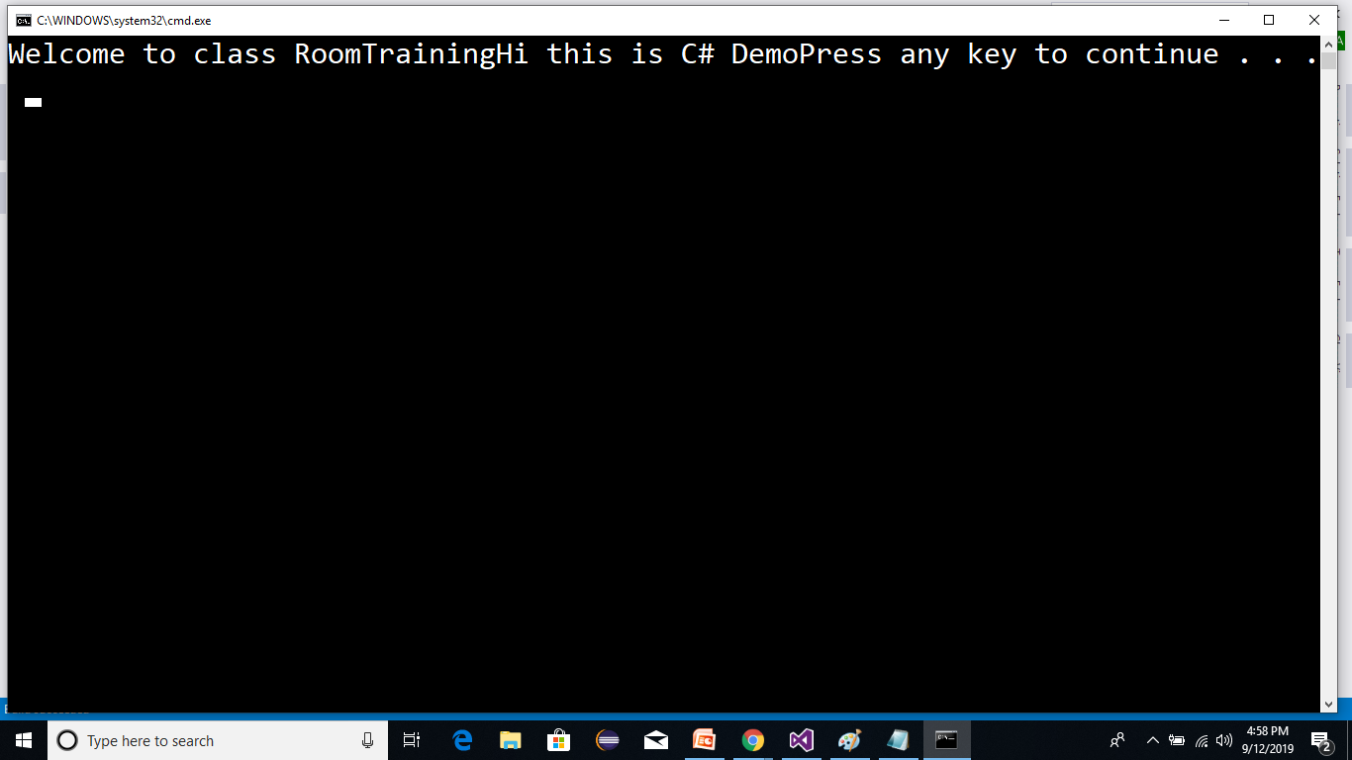
After Executing VS
After Executing the project We get
out put.

Slide 23
Example on Data Types with Out put methods
static void Main(string[] args)
{
int a = 10;
float x = 4.5f;
double d = 7.8;
string s = "Welcome";
decimal m = 5.6m;
Console.WriteLine("{0} {1} {2} {3} {4}",a,x,d,s,m);
}

Slide 24
Input and Out Put Methods
Input Methods
These are used to read values from the console.
Tyey are
Console.ReadLine()
Console.Read()
Console.ReadKey()

Slide 25
Input and Out Put Methods
Console.ReadLine()
It is used to read a string
Int.Parse(Console.ReadLine())
It is used to Read Integer Value
Float.Parse(Console.ReadLine())
It is used to Read Float value.
Double.Parse(Console.ReadLine())
It is used to Read double value.
Bool.Parse(Console.ReadLine())
It is used to boolean value
Console.Read()
It used to Read ASCII Value of the given Character.
Console.ReadKey()
It is used to read a key from the console

Slide 26
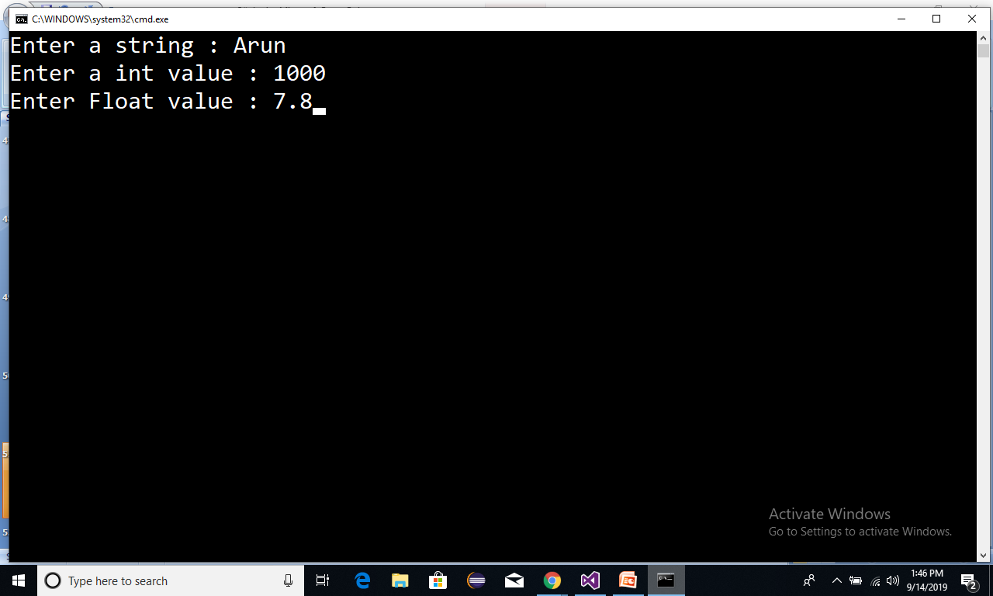
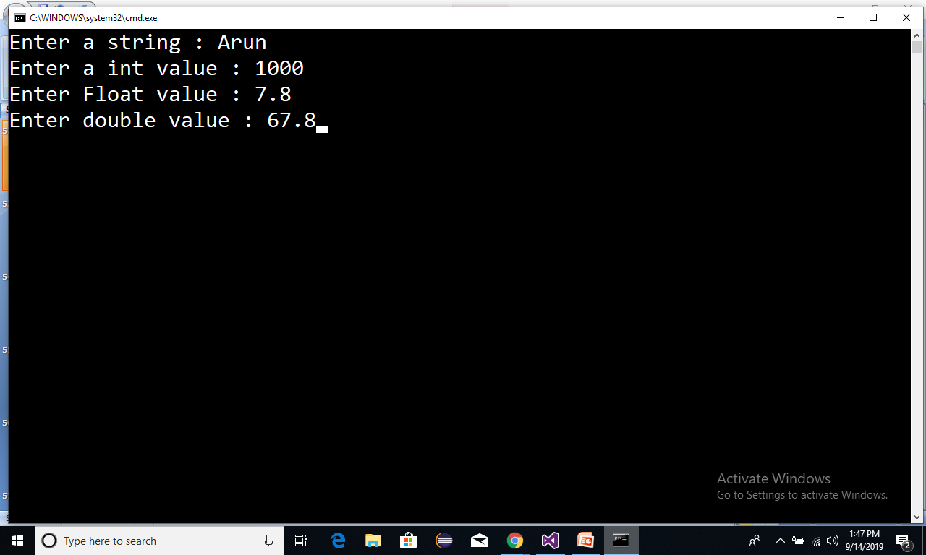
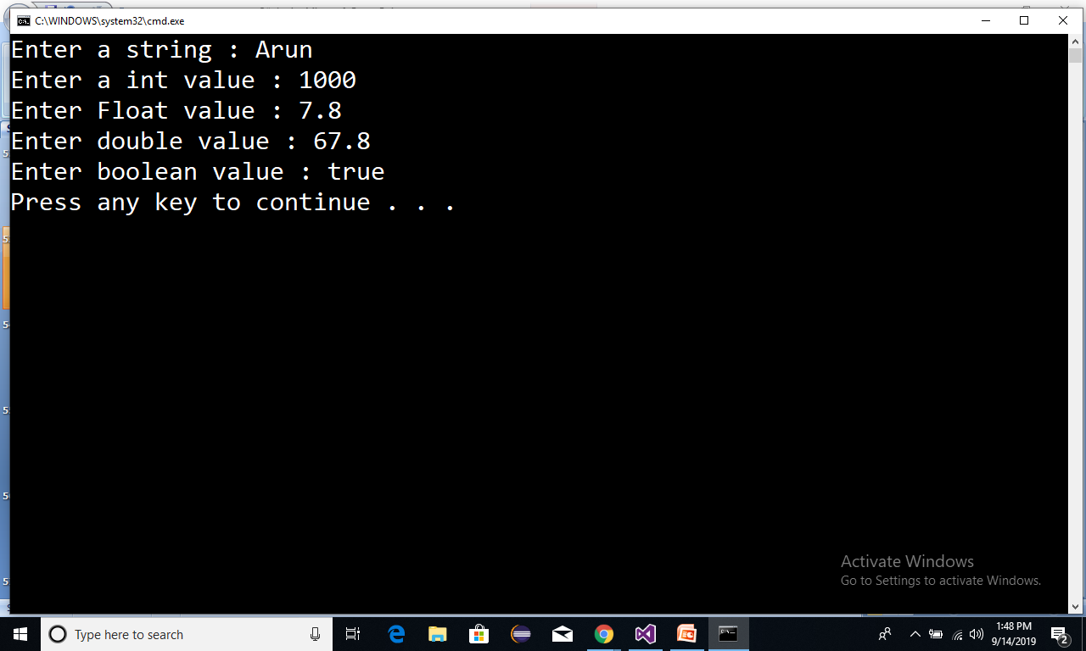
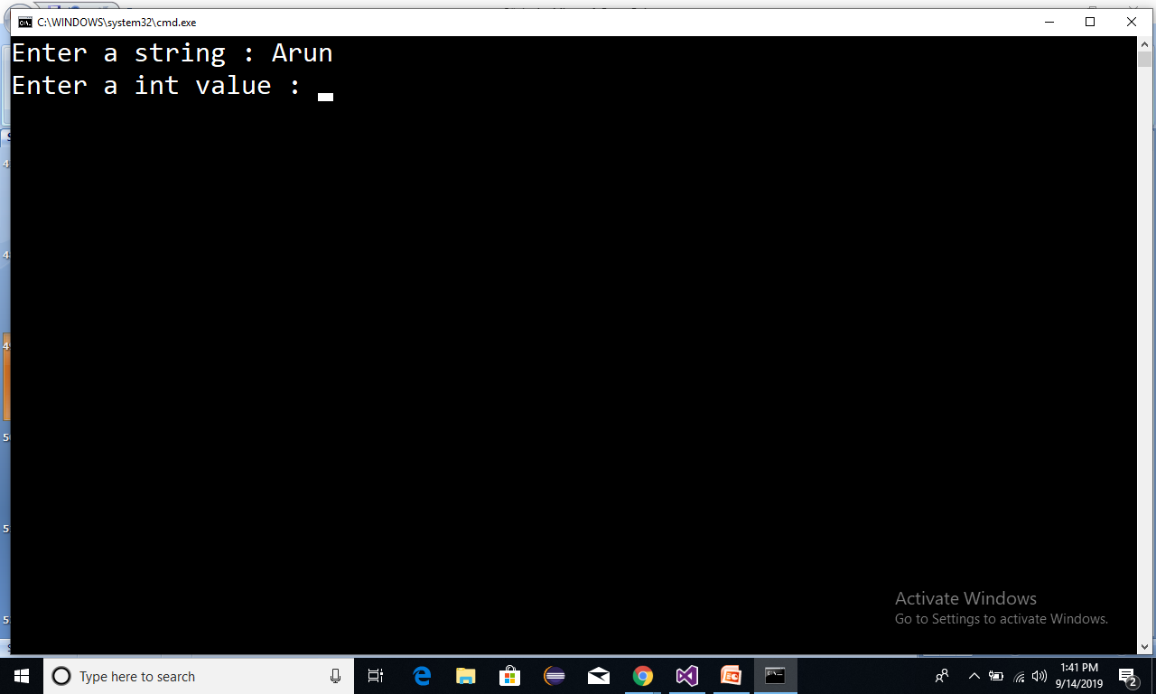

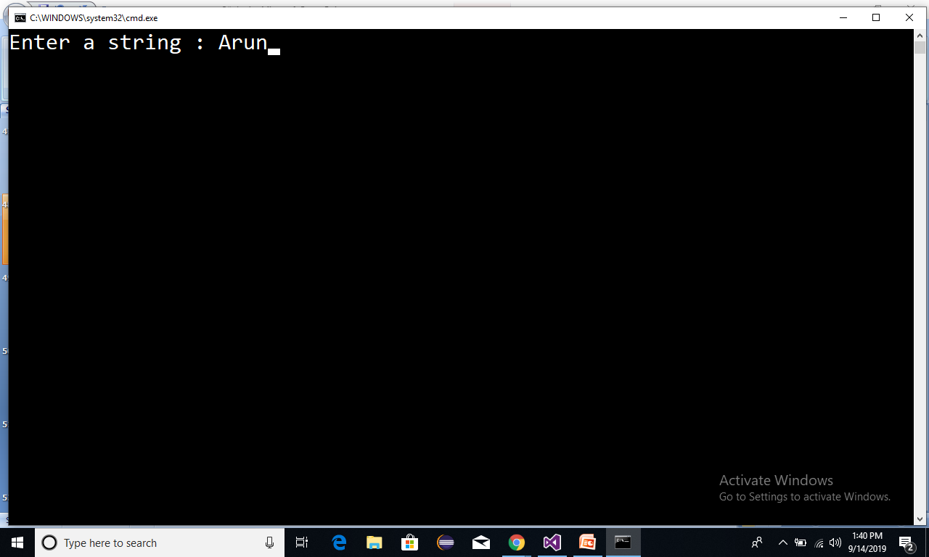
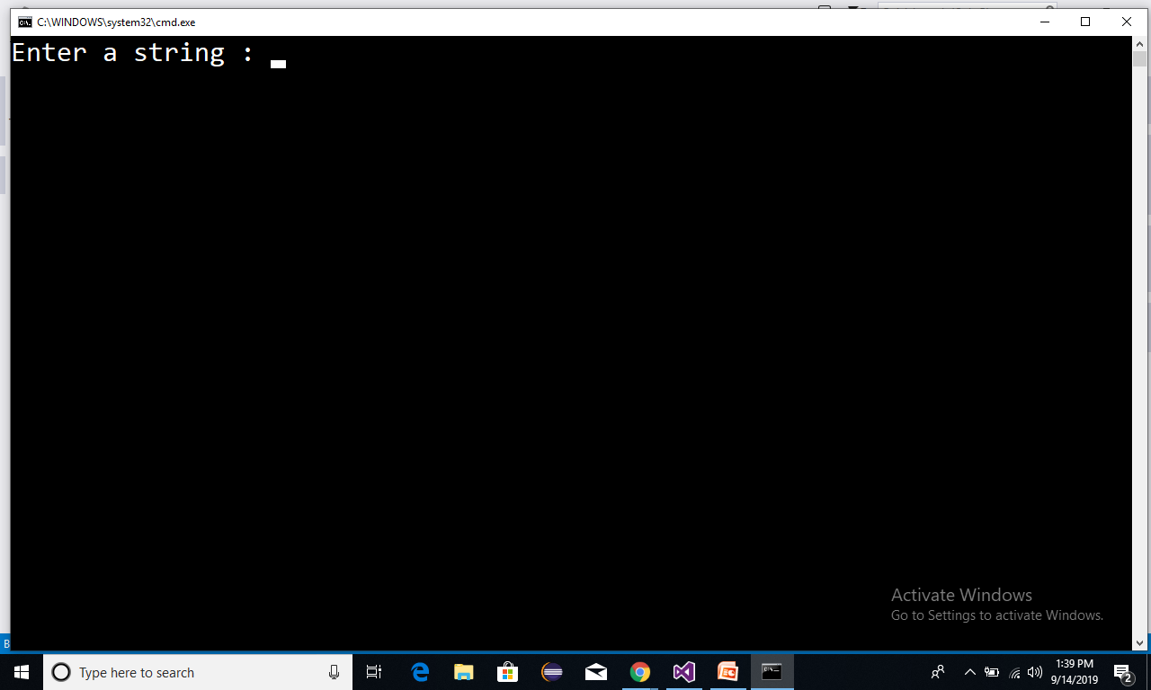
Reading values
static void Main(string[] args)
{
Console.Write("Enter a string : ");
string s = Console.ReadLine();
Console.Write("Enter a int value : ");
int a = int.Parase(Console.ReadLine());
Console.Write("Enter Float value : ");
float f =float.Parse(Console.ReadLine());
Console.Write("Enter double value : ");
double d =double.parse(Console.ReadLine());
Console.Write("Enter boolean value : ");
bool b =bool.Parse( Console.ReadLine());
}

Slide 27
Operators
Operators
In
C#

Slide 28
Operators in C#
Arithmetic operators .
Relational operators(Comaprision Operator).
Logical Operators.
Assignment operators.
conditional operators.
Increment and Decrement operators.
Bitwise Operators.// home work

Slide 29
Arithmetic operators .
+ -> add
- ->sub
* ->mul
/ ->div-->quo 5/2 ---> 2
% ->mode->Rem 5%2 --->1

Slide 30
Arithmetic operators .
static void Main(string[] args)
{
int a = 5;
int b = 2;
Console.WriteLine("Sum:{0}",a+b);
Console.WriteLine("Sub:{0}",a-b);
Console.WriteLine("Mul:{0}",a*b);
Console.WriteLine("Quo:{0}",a/b);
Console.WriteLine("Rem:{0}",a%b);
}
Sum : 7
Sub : 3
Mul : 10
Quo : 2
Rem: 1

Slide 31
Relational operators:
> ->Greter
< ->less
>= ->Greaterthan or equal
<= ->Lesserthan or equal
== ->(comparision)
!= ->(Not Equal)

Slide 32
Relational operators
static void Main(string[] args)
{
int a = 5;
int b = 2;
Console.WriteLine("a > b : {0}", a > b);
Console.WriteLine("a >= b : {0}", a >= b);
Console.WriteLine("a < b : {0}", a < b);
Console.WriteLine("a <= b : {0}", a <= b);
Console.WriteLine("a == b : {0}", a == b);
Console.WriteLine("a != b : {0}", a != b);
}
a > b:True
a >= b :True
a < b : False
a <= b : False
a == b : False
a != b :True

Slide 33
Logical Operators
&&- --> and
|| ---> or
! ---> not
con1 con2 con1 && con2
true true true
true false false
false true false
false false false
con1 con2 con1 || con2
true true true
true false true
false true true
false false false
con !con
true false
false true

Slide 34
Assignment operators
= Assignment operator
+= Additive Assignment
-= Subtractive Assignment
*= Multiplicative Assignment
/= Division Assignment

Slide 35
Assignment Operators program
static void Main(string[] args)
{
int a = 10;
int b = 20;
Console.WriteLine("a = {0}",a);
a += b; // a = a+b
Console.WriteLine("a = {0}", a);
a -= b;
Console.WriteLine("a = {0}", a);
a *= b;
Console.WriteLine("a = {0}", a);
a /= b;
Console.WriteLine("a = {0}", a);
}
a = 10
a = 30
a = 10
a = 200
a = 10

Slide 36
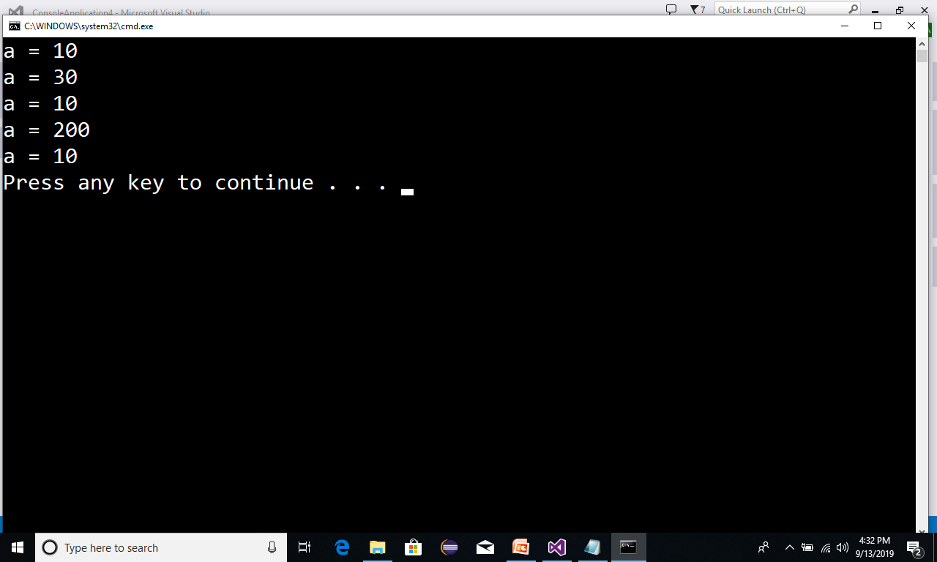
Assignment operators:

Slide 37
Conditional operators
? : (Ternary Operator)
con? Stmt1 : stmt2;
con-->True--->stmt1 can be executed
con--->False-->stmt2 can be executed

Slide 38
Conditional Operators program
static void Main(string[] args)
{
bool con = true;
Console.WriteLine(con?"Hi":"Bye");
}
Hi

Slide 39
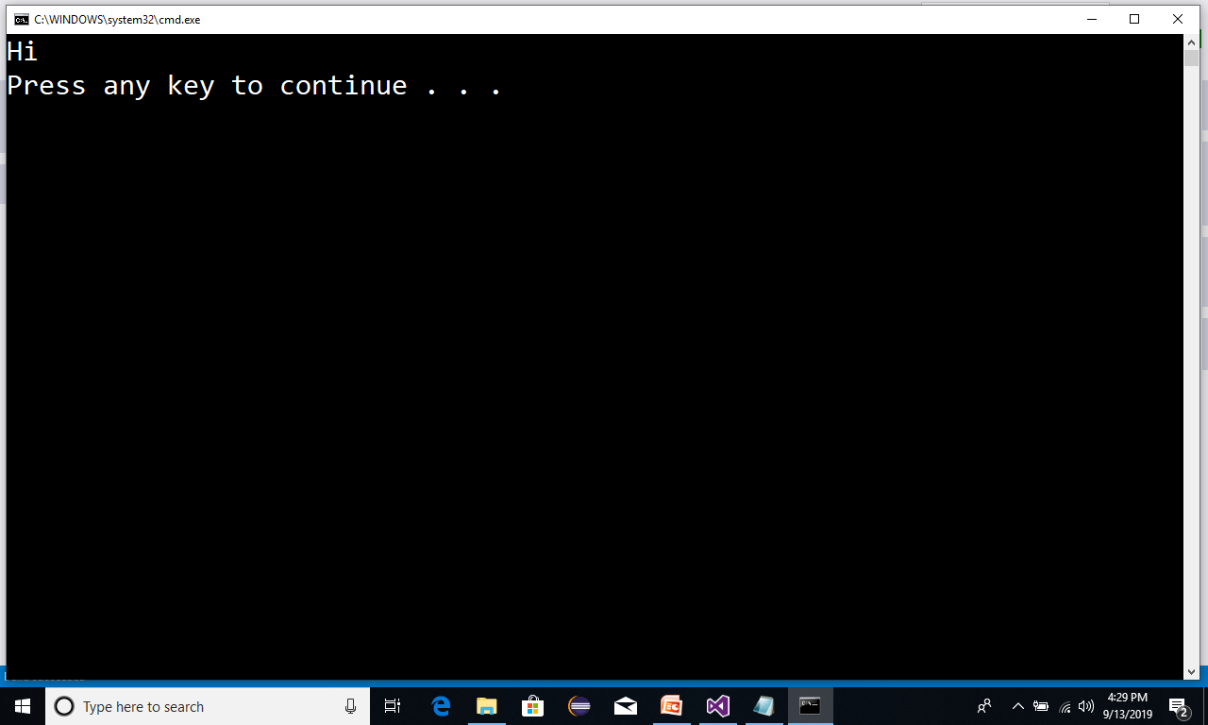
Conditional operators:

Slide 40
Conditional Operators program
static void Main(string[] args)
{
bool con = false;
Console.WriteLine(con?"Hi":"Bye");
}
Bye

Slide 41
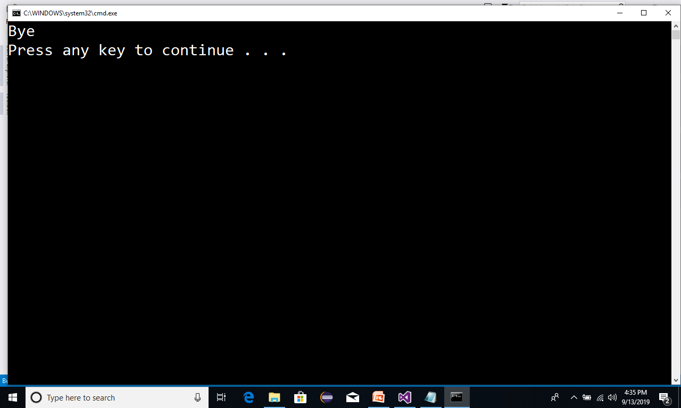
Conditional operators:

Slide 42
Increment and Decrement operators
++ Increment Operator
-- Decrement Operator

Slide 43
Increment and Decrement Operators program
static void Main(string[] args)
{
int a = 10;
int b = 20;
Console.WriteLine("a = {0}",a++); // Post Increment
Console.WriteLine("a = {0}", a);
Console.WriteLine(“b = {0}", ++b); // Pre Increment
Console.WriteLine(“b = {0}", b);
}
a = 10
a = 11
a = 21
a = 21

Slide 44
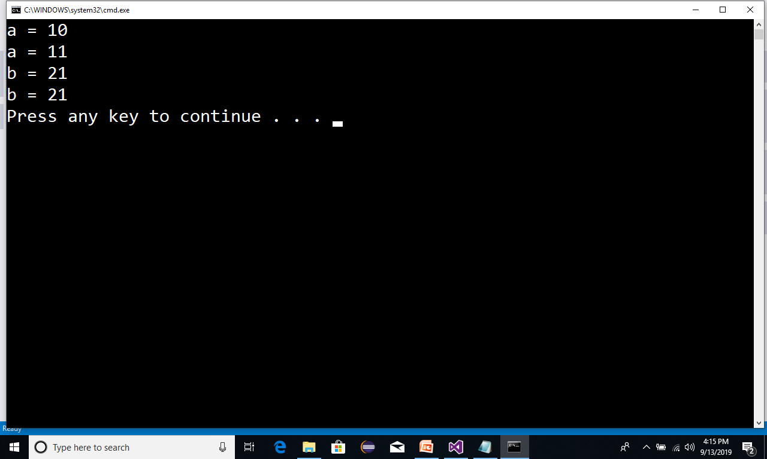
Increment decrement operators:

